Slide 1

TCHHN Joint Commission Disease Specific Care Certification Programs
Provider Education
VAD
Palliative Care
Primary Stroke Care
Advanced Heart Failure
Inpatient Diabetes Care
Total Hip and Knee Replacement
Updated June 2026

Slide 2
JC Certification Program Components
Structure
Survey every two years
Processes
Adoption of Clinical Practice Guidelines (CPG)
Outcomes
Standardized performance measures
Disease Specific / Patient Population focused
Medical Director
Clinical Director/ Manager
Core Interdisciplinary Team
Evidenced based care to guide clinical practice
Order sets
Protocols
Patient Satisfaction
Organized Quality Assessment Performance Improvement (QAPI) meetings
Improved Throughput
Promotes TCHHN programs

Slide 3

Advanced Heart Failure Program Requirements
CHF order set
for all acute HF patients
Includes consults for Pastoral services (ACP discussion & depression screen)
HF service consult
Consider if EF <30%, worsening renal or liver failure, readmission for Heart Failure
Documentation requirements
DC Smartphrase {.DCHF} auto populates required documentation based on EF (includes NYHA class, GDMT)
7-day HF follow up appointment
Enter consult for ‘Heart Failure Follow Up’ to prompt HUC/RN to schedule appointment
inpatient Cardiac rehab (Functional capacity assessment, PGA, ambulation, HF education)
Heart Link (follows all HF patients)
Secure chat “Heart Link” or 513-585-CHF5 with any questions

Slide 4
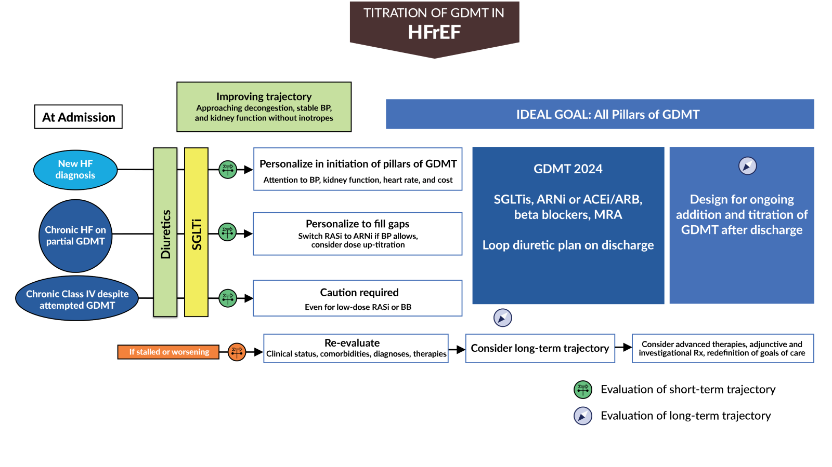
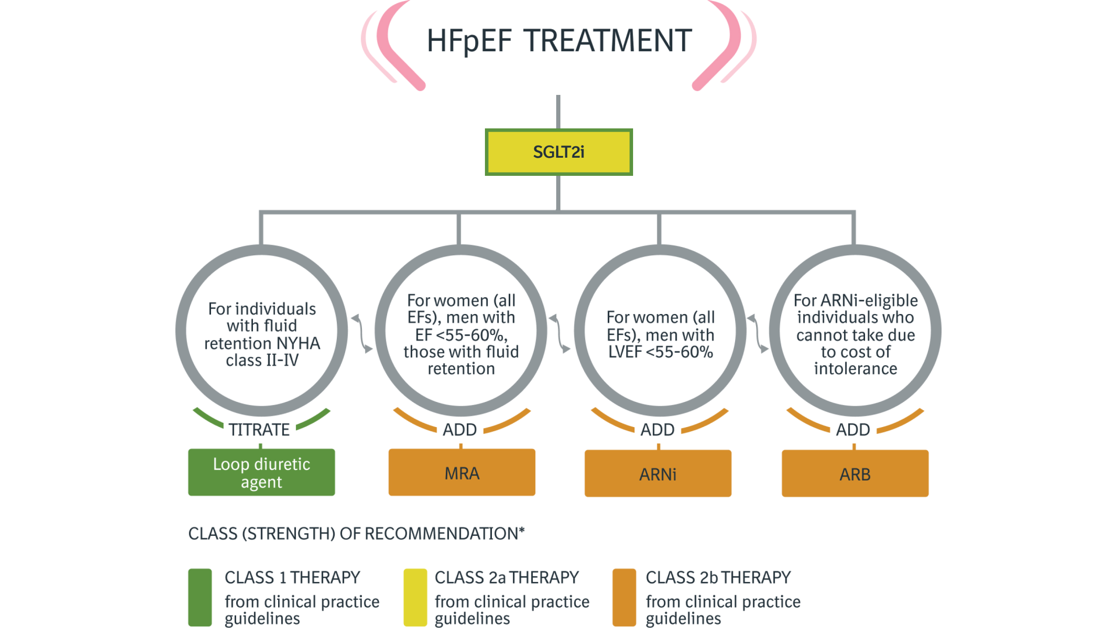
Advance Heart Failure CPG Updates and Emphasis
Updates the previous guidelines by emphasizing the establishment of all four pillars of GDMT during hospitalization when possible.
Highlights the importance of decongestion and optimizing neurohormonal therapies, including the use of diuretics and adjunctive therapies based on new data.
Allows for SGLT inhibitors to be initiated at any time during the treatment process, including during hospitalization, regardless of the left ventricular ejection fraction.
2024 ACC Expert Consensus Decision Pathway on Clinical Assessment, Management, and Trajectory of Patients Hospitalized With Heart Failure Focused Update - Guidelines Spotlight - Guideline Central
2023 ACC Expert Consensus Decision Pathway on Management of Heart Failure With Preserved Ejection Fraction: A Report of the American College of Cardiology Solution Set Oversight Committee | JACC

Slide 5
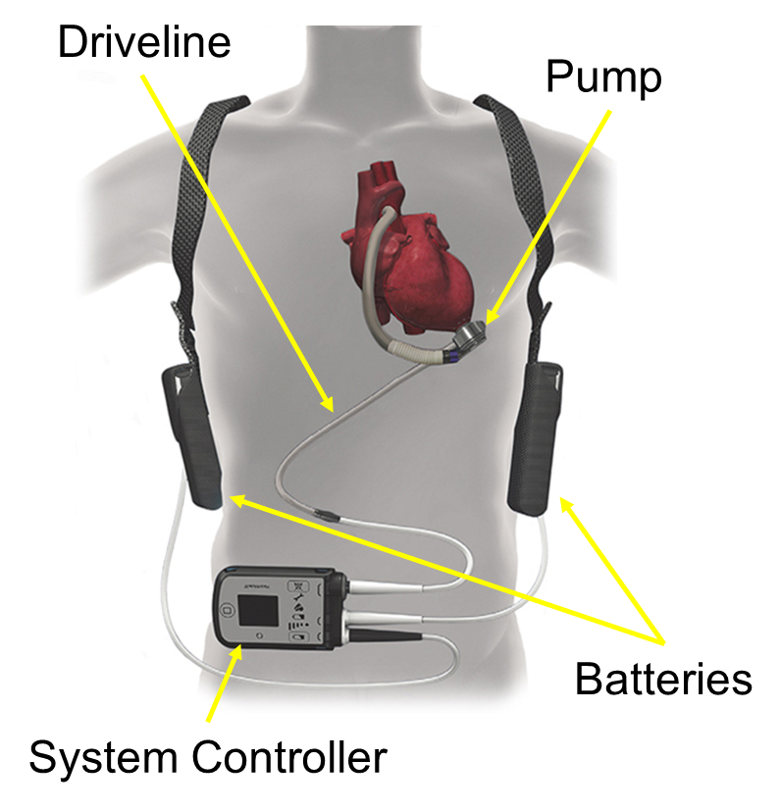
LEFT VENTRICULAR ASSIST DEVICE (LVAD) PROGRAM SPECIFICS
The Christ Hospital heart failure physician team evaluates patients for both heart transplant and left ventricular assist device (LVAD).
Indications for LVAD therapy include:
Bridge to Transplant (BTT) / short-term: supports heart function while patient is awaiting a heart transplant
Destination Therapy (DT) / long-term: therapy for patients that are not a candidate for heart transplant at the time of implant
When to refer to an advanced heart failure specialist:
I IV Inotropes
N NYHA IIIB/IV or persistently elevated natriuretic peptides
E End-organ dysfunction (liver, kidney, mental status)
E Ejection fraction ≤ 30%
D Defibrillator shocks
H Hospitalizations > 1
E Edema despite escalating diuretics
L Low blood pressure, high heart rate
P Progressive intolerance or down-titration of guideline directed medical therapy
Also, refer patients for more than moderate mitral regurgitation.
To refer a patient for heart transplant or LVAD evaluation, place a consult to the heart failure physicians (inpatient) or call 513-585-4944 (outpatient). For additional provider education regarding the LVAD, call 513-585-0809.
2017 ACC Expert Consensus Decision Pathway for Optimization of Heart Failure Treatment: Answers to 10 Pivotal Issues About Heart Failure With Reduced Ejection Fraction
http://www.onlinejacc.org/content/early/2017/12/12/j.jacc.2017.11.025

Slide 6
Palliative Care Program Specifics
Palliative care is specialized medical care for people living with a serious illness. It is focused on providing relief from the symptoms and stress of an illness. The goal is to improve quality of life for both the patient and family. Palliative care is provided by a specially-trained team of doctors and advanced practice providers, nurses, pharmacists, chaplains, and social workers. Care is based on the need of the patient, not the prognosis. It is appropriate at any age and any stage of a serious illness and can be provided along with curative treatment.
It is the standard of care at The Christ Hospital for patients with stage IV cancer, ECMO, LVAD, and Heart Transplant (w/u and 1st year post transplant) to have palliative care consultation during a hospital stay.
Palliative Care can help with:
  Complex medical decision making (like prognosis and goals of care discussions)
  Advance care planning (like code status and surrogate decision-making)
  Pain and symptom management
  Psychosocial and Spiritual suffering
Contacting the Palliative Care Team:
  Providers are available 24/7
  Palliative Oncology Clinic is available for TCH patients with cancer and in the LVAD/Transplant Clinics
  Consults can be placed through Epic
  Call 585-4157 to contact the team

Slide 7
Primary Stroke Care Program Specifics
Includes ischemic stroke, non-traumatic hemorrhagic stroke, and TIA
Caring for Primary Care Stroke Patients :
Use of Primary Stroke Order Sets: Stroke Add On #761, ICU Hemorrhagic #2215, Subarachnoid Hemorrhagic #2348, Code Stroke #789, Thrombolytics Order Set #1816, Angioedema Order Set.
Contacting the Primary Care Stroke Team:
TriHealth STANSE Stroke Program Relationship is engaged by the utilization of the #789 order set. STANSE via Telehealth to arrive to bedside within 10 minutes.
Reduces delays due to inconsistent or incomplete orders
Code Stroke Algorithm:
Inpatients Activate by Calling 119
Optimizes the prompt assessment and management of patients with stroke symptoms that lead to faster stroke interventions and are associated with better outcomes
Expert consulting for FASTER recognition of IV Tenecteplase administration (Goal < 60 minutes) and/or transfer for thrombectomy and other neurovascular procedures (Goal < 120 minutes)
Emergency Department Main-Staff brings pt to Hallway Bed 4, MD arrives to bedside, performs assessment, determines Code Stroke need if so, places order set #789
Liberty ED- Stroke alert is initiated, MD arrives to bedside, performs assessment, determines a Code Stroke alert is needed and places order set #789

Slide 8
Primary Stroke Care Program Specifics
The program develops a standardized process originating in clinical practice guidelines (CPGs) or evidence-based practice to deliver or facilitate the delivery of clinical care. The program demonstrates evidence that it is following the clinical practice guidelines when providing care, treatment, and services.
• The program must demonstrate evidence that it is following the clinical practice guidelines when providing care, treatment, and services as evidenced by using fluid recommended for Acute Ischemic Stroke of normal saline. If a different fluid is selected to treat the patient the provider must document in the EMR the reason for the change of fluids
• Primary Stroke Program CPGs are located on MYTCH -Departments-Stroke Program-Clinical Resources-Open Clinical Practice Guidelines.docx
• Use of Primary Stroke Order Sets: Stroke Add On, ICU Hemorrhagic, Subarachnoid Hemorrhagic, Acute Ischemic Stroke reduces delays due to inconsistent or incomplete orders
• The use of standardized stroke care order sets is recommended
to improve general management such as Dysphagia management. Should a patient fail the H2O test, the patient must have a Speech Pathology consult and remain NPO including medications.

Slide 9
Intravenous Fluids Clinical Practice Guideline
• Patients presenting with acute ischemic stroke are predominantly either euvolemic or hypovolemic
• Hypovolemia may predispose to hypoperfusion and exacerbate the ischemic brain injury, cause renal impairment, and potentiate thrombosis. Hypervolemia may exacerbate ischemic brain edema and increase stress on the myocardium. Thus, euvolemia is desirable
• For patients who are euvolemic at presentation, clinicians should initiate maintenance intravenous fluids
• A substantial proportion of hypotonic solutions, such as 5% dextrose (after the glucose is metabolized) or 0.45% saline, is distributed into the intracellular spaces and may exacerbate ischemic brain edema. Isotonic solutions such as 0.9% saline are more evenly distributed into the extracellular spaces (interstitial and intravascular) and may be better for patients with acute ischemic stroke
• Hypovolemia should be corrected with intravenous normal saline, and cardiac arrhythmias that might be reducing cardiac output should be corrected
• If a different fluid is selected to treat the patient the provider must document in the EMR the reason for the change of fluids

Slide 10
Inpatient Diabetes Program Specifics
Hospital Blood Glucose Target: 100- 180 mg/dl
Caring for Inpatient Diabetes Patients :
Order A1C if not checked within past 3 months
Document type of diabetes and diabetes control in daily progress note
All patients with diabetes or receiving insulin should have POCT glucose orders
Utilize Basal/Bolus Insulin with Calculator Order Set (1857)
Review blood glucose daily and adjust insulin as needed
Diabetes APP requires a consult for all patients:
Consider Diabetes APP consult for glycemic management of any patient
With an insulin pump
Taking U-500 insulin
Continuous Glucose Monitor – patient wearing from home
Order Set 2360 required for patient to continue wearing the CGM sensor from home.
**Do not refer to Diabetes APP just for CGM use.**
Continuous Glucose Monitor Hospital Discharge Program:
Insulin pump patients admitted during Diabetes APP after hours (7 pm-7 am) utilize the Insulin Pump and Continuous Glucose Monitor Holding Order Set (3288)
Utilized for patients who have never tried a CGM in the past.
Specific requirements must be met for a patient to be offered a CGM sample.
**Sample CGMs are not provided as replacements for patients who have their own supplies at home.**
Coverage is not determined when a sample is provided. Patient is instructed to see their PCP or Endocrinologist for a prescription.

Slide 11
Inpatient Diabetes Program Specifics
Referrals to Inpatient Diabetes Education:
Automatic consults include:
Contacting the Inpatient Diabetes Program Team:
Our service is available Monday-Friday, 7:30 am-4 pm. Each unit has diabetes education materials and supplies to provide hands on education if this service is unavailable.
We can be reached at 513-585-2072 or via Secure Chat.
Inpatient diabetes education consult in EPIC if needed.
Insulin pumps
U-500 insulin
Glucose level >400
DM Comprehension
Additional reasons for referrals:
Hyperglycemia d/t steroid use
Cardiac patients (including CVRU)—A1C >8, Pre-op A1C 5.7 or higher.
Pre-diabetes
Nutrition counseling (related to CHO/CHO counting/effect of proteins and fats on glucose)
Newly diagnosed Type 1 and 2.
Insulin—education, review, assess patients’ ability to administer.
Using a set dose + correction scale—is patient able to calculate doses
Gestational diabetes/Type 1 or 2 on post-partum units
Continuous Glucose Monitors
Hypoglycemia
DKA/HHS—sick day management
Heart transplant patients

Slide 12
Advanced Hip and Knee Program
Use of Standardized Order Sets
Pre-op class and education, includes an extensive patient education booklet
Care Team Availability
Clinical Practice Guidelines
Preop Antibiotic Selection
Early mobilization
In-person or online preop education class available for all total joint patients
After-Hours Clinic available for any post op concerns in the evenings 5:00pm – 7:30pm
Montgomery Walk-In clinic available as another resource for post op concerns for patients during normal business hours
Newly updated patient education booklets
Includes Case Request Major Orthopedic Pre-Surgery, Major Orthopedic Pre-Surgery, Orthopedic Same Day Surgery, Total Joint Lower Extremity Post Op, Hip Fracture Post-Op, ASC Preop Anesthesia
Tranexamic Acid use, timing of administration, dosing
The use of preoperative antibiotic (primary choice of Cefazolin) to reduce risk of PJI
Use and treatment of TXA decreases postoperative blood loss and reduces the necessity of postoperative transfusions
Total Joint Replacement patients undergo early mobilization following elective hip and knee arthroplasty.
On-call physicians available 24/7 in office

Slide 13
Total Hip and Total Knee Replacement Standard Performance Measures
Regional Anesthesia
  Documentation that regional anesthesia was performed or attempted. Includes neuraxial anesthesia (spinal and epidural blocks) and peripheral nerve blocks
Postoperative Ambulation on the Day of Surgery
  Documentation that the patient ambulated postop the day of surgery, in the PACU, or within 4 hours of discharge from the PACU.
Discharged to Home
  Patients are discharged to home with or without home health services, in-home physical therapy, or outpatient physical therapy.
Preop Functional/Health Status Assessment
  Patients who completed the general health and joint-specific functional status assessments within 90 days prior to surgery.
Postop Functional/Health Status Assessment
  Patients who completed the general health and joint-specific functional status assessments within 300-425 days after surgery.
Each is assessed for all segments of the population (Inpatient and Outpatient) and (Total Hip and Total Knee)

